Slide 1
Employee Data Analysis using Excel
STUDENT NAME: SHALINI.K
REGISTER NO: 122203101 [unm14512022h41]
DEPARTMENT: B.COM(Corporate secretaryship)
COLLEGE: MAHALASHMI WOMENS COLLEGE OF
ARTS AND SCIENCE

Slide 2
PROJECT TITLE
Employee Performance Analysis using Excel

Slide 3


AGENDA
Problem Statement
Project Overview
End Users
Our Solution and Proposition
Dataset Description
Modelling Approach
Results and Discussion
Conclusion
3/21/2024 Annual Review

Slide 4

PROBLEM STATEMENT
Employee performance analysis in Excel typically involves evaluating and visualizing data related to employee productivity, quality of work, attendance, and other performance indicators. Here's a step-by-step guide to conducting an employee performance analysis using Excel:
1. Data Collection
2. Data Organization
3. Data Entry
4. Data Analysis
5. Visualization
6. Performance Ratings
7. Reporting
8. Interpretation & Decision Making

Slide 5

PROJECT OVERVIEW
.
Analyzing employee performance using Excel involves various steps, from.collecting and organizing data to applying formulas, creating visualizations, and generating reports. Here's a general guide on how to conduct an employee performance analysis in Excel:
Collect and Organize Data
Data Cleaning
Apply Formulas for Analysis
Create Visualizations
Pivot Tables for In-Depth Analysis
Generate Reports
Interpret Results and Take Action

Slide 6

WHO ARE THE END USERS?
IT Companies
Banks
Industries
Human Resource Development

Slide 7

OUR SOLUTION AND ITS VALUE PROPOSITION
Conditional Formatting
Filtering
Formula
Pivot Table
Bar Chart
Pie Chart

Slide 8
Dataset Description
Employee data downloaded from edunet dashboard
Features:
Totally 26 features were available in that 4 were considered
Gender Code
First name
Business unit
Performance level

Slide 9

THE "WOW" IN OUR SOLUTION
=IFS(J8>=5,"Very high",J8>=4,"High",J8>=3,"Med","True","Low")
3/21/2024 Annual Review

Slide 10
MODELLING
Summerising:
Pivot table is created to summerise
Filter - Gender code
Column - Performance level
Rows - Business unit
Values - Count of first name
Visualisation:
Bar graph
Pie chart

Slide 11
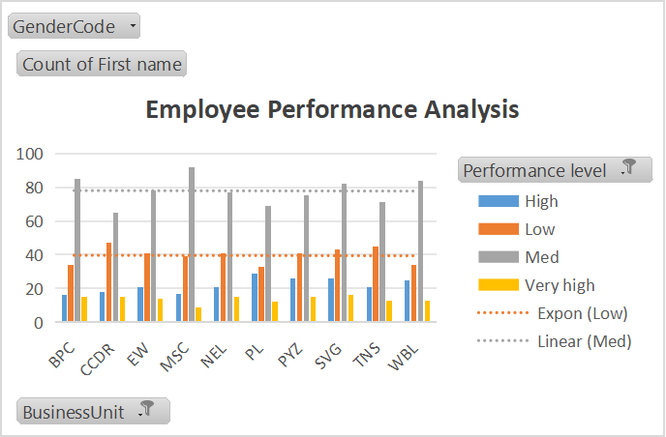
Results

Slide 12
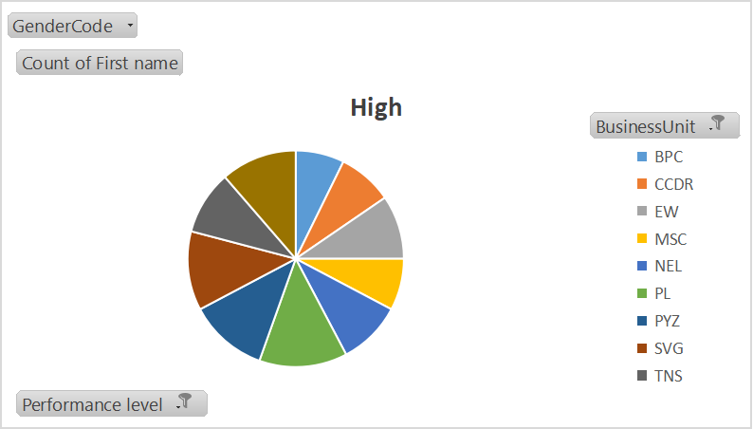
Results

Slide 13
conclusion
The "Employee Performance Analysis Using Excel" project provides a robust and user- friendly solution for evaluating and managing employee performance. By leveraging Excel's powerful tools such as filtering, pivot tables, charts, and conditional formatting the project transforms raw performance data into actionable insights.

